Slide 1

Essay Writing
Essay writing builds on many of the skills you have already mastered in learning to write a paragraph. Once you know how to write a paragraph, it is not much more difficult to write an essay; an essay is just longer. Simply stated, an essay is a group of paragraphs about specific subject. Like a paragraph, an essay makes and supports one main point.

Slide 2
Parts of an Essay
An essay has three main parts: an introduction, several supporting paragraphs, and a conclusion. The supporting paragraphs are also called the body. Each part has its own special purpose. The introduction provides some background information on the subject and states the main idea in a thesis statement. The supporting paragraphs explain and support the main idea. The conclusion summarizes the main points.

Slide 3
Basic Plan of an Essay
INTRODUCTION
Background Information
Gets reader’s attention using one or more of the following:
Anecdotes, Quotations, Questions, Facts and statistics
Thesis Statement
States the subject and focus of the essay
INTRODUCTION

Slide 4
Basic Plan of an Essay
Anecdote:
Sometimes your biggest weakness can become your biggest strength. Take, for example, the story of one 10-year-old boy who decided to study judo despite the fact that he had lost his left arm in a devastating car accident.
INTRODUCTION

Slide 5
Basic Plan of an Essay
Quotations
About life:
Life's most persistent and urgent question is, 'What are you doing for others?‘
About hometown:
You never get away from that thing in your hometown that it has over you. You don't outgrow where you come from.

Slide 6
Basic Plan of an Essay
Facts
In no case should abortion be promoted as a method of family planning. All governments and relevant intergovernmental and nongovernmental organizations are urged to strengthen their commitment to women's health, to deal with the health impact of unsafe abortion* as a major public health concern and to reduce the recourse to abortion through expanded improved family planning services. Prevention of unwanted pregnancies must always be given the highest priority, and all attempts should be made to eliminate the need for abortion.

Slide 7
Basic Plan of an Essay
Statistics
In 2015, a total of 229,715 babies were born to women aged 15–19 years, for a birth rate of 22.3 per 1,000 women in this age group. This is another record low for U.S. teens and a drop of 8% from 2014. Birth rates fell 9% for women aged 15–17 years and 7% for women aged 18–19 years.

Slide 8
Introduction
Example:
Many modern children spend too much time sitting in front of a television screen. This is extremely harmful to their development. Therefore Parents should strictly limit the time that children spend in this way. Do you agree?
Or,
TV is so common now that it is hard to imagine life without it. However, as many people have pointed out, most children spend too much time in front of the screen, and this is harmful.

Slide 9
Introduction: Activity 1
Modern technology has increased our material wealth, but not our happiness. To what extent do you agree with this statement?
Some people claim that modern technology is harming society’s spiritual and traditional values.
In fact, in many cases people have suffered enormously because of these changes.
Every country in the world is aiming for technological development.
Their governments are not making their people more contented, however, as inequalities in society continue to grow.
It seems clear however, that this is an old-fashioned view, and that technological inventions actually allow people to have more time and leisure to satisfy their spiritual needs.
For most people, technological development means an improvement in their life-style.
Technology has brought many changes to peoples lives, not all of which are beneficial.
The following are 3 introductions to the essay topic. However, the sentences have been jumbled. Find the first and second sentences which belong together in each case, to make five different introductions. There is one extra sentence.

Slide 10
Introduction: Activity 1 (answers)
Modern technology has increased our material wealth, but not our happiness. To what extent do you agree with this statement?
1. Some people claim that modern technology is harming society’s spiritual and traditional values. 5. It seems clear however, that this is an old-fashioned view, and that technological inventions actually allow people to have more time and leisure to satisfy their spiritual needs.
7. Technology has brought many changes to peoples lives, not all of which are beneficial. 2. In fact, in many cases people have suffered enormously because of these changes.
3. Every country in the world is aiming for technological development. 6. For most people, technological development means an improvement in their life-style.

Slide 11
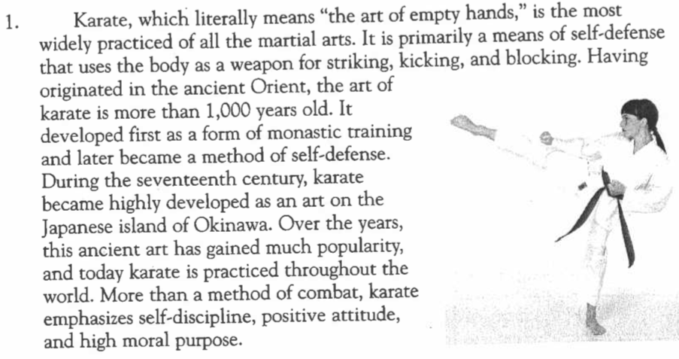
Introduction: Activity 2
Read the following sample introductions. Then identify the technique or techniques used in each one. Remember that authors often use a combination of techniques to write an introduction.

Slide 12
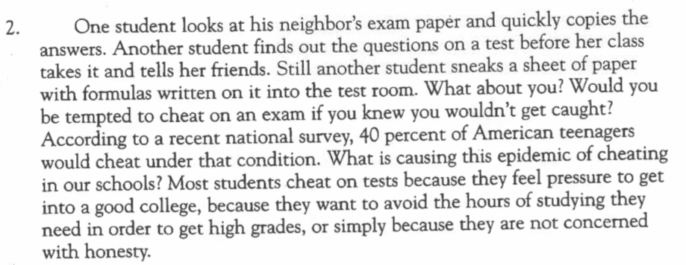
Introduction: Activity 2
Read the following sample introductions. Then identify the technique or techniques used in each one. Remember that authors often use a combination of techniques to write an introduction.

Slide 13
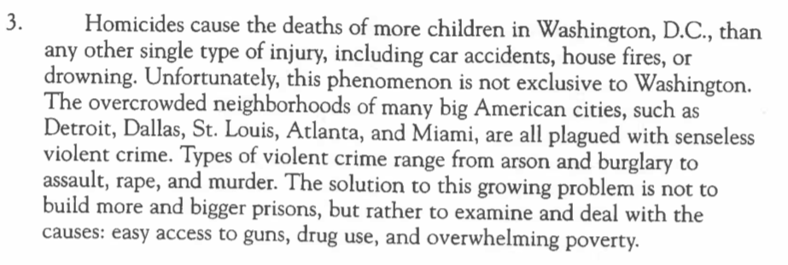
Introduction: Activity 2
Read the following sample introductions. Then identify the technique or techniques used in each one. Remember that authors often use a combination of techniques to write an introduction.

Slide 14
Introduction: Activity 2
Read the following sample introductions. Then identify the technique or techniques used in each one. Remember that authors often use a combination of techniques to write an introduction.
Misty, a five-month-old German shepherd puppy, goes to the hospital twice a week, but not to see a veterinarian. At this Veteran's Administration hospital, Misty is helping doctors - not the other way around. In what may seem like a role reversal, animals like Misty are visiting the halls of human illness to relieve a type of pain doctors cannot treat. Their therapy is love, both giving it and helping others return it to them. Pets ranging from dogs to tropical fish are showing up as therapists in hospitals, nursing homes, prisons, and other institutions.

Slide 15
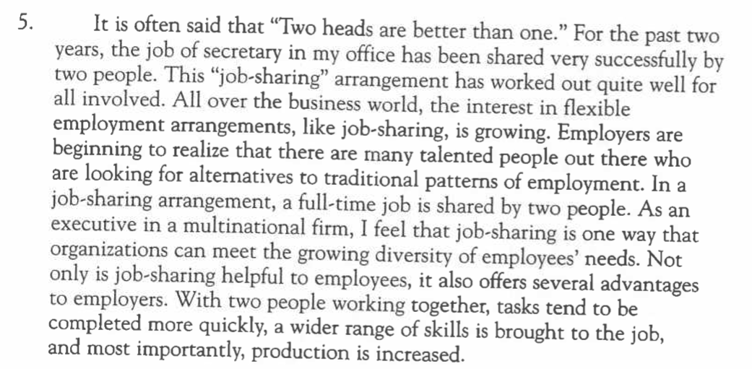
Introduction: Activity 2
Read the following sample introductions. Then identify the technique or techniques used in each one. Remember that authors often use a combination of techniques to write an introduction.

Slide 16
Introduction: Activity 2
Write introductions for the following topics, remembering to:
write a general statement in your first sentence
indicate your own position or stand on the topic in the second or third sentence.
paraphrase the words of the topic.
1. It is generally agreed that the world. is faring serious environmental problems of pollution, global warming and the loss of resources such as fresh water. Some people believe that these problems can be solved by technological inventions and developments, while others feel strongly that we can only solve these problems by consuming less, and living simpler life-style. What is your opinion?

Slide 17
Introduction: Activity 2
Write introductions for the following topics, remembering to:
write a general statement in your first sentence
indicate your own position or stand on the topic in the second or third sentence.
paraphrase the words of the topic.
2. Many people feel strongly that health services should be provided by the government and should be freely available. Others argue that only privatized health care can provide good quality health services. To what extent do you believe that health and medical services should be privatized?

Slide 18
Basic Plan of an Essay
1st SUPPORTING PARAGRAPH
Topic Sentence: States first supporting point
Provides supporting point
2nd SUPPORTING PARAGRAPH
Topic Sentence: States second supporting point
Provides details, examples, facts
BODY
Notes:
To introduce the topic and explain why it is worthwhile talking about, you will normally need a statement something like this:

Slide 19
Basic Plan of an Essay
CONCLUSION
Makes final comments by doing one or more of the following:
Restating main points
Asking a question
Suggesting a solution
Making a recommendation
Making a prediction
Conclusion

Slide 20
Essay Writing
Latin Pop Music Hits the United States
Since the late 1990s, Latin music has exploded onto the U.S. music scene like never before. There has been a steady increase in the records sales of Latin music albums and remarkable growth in the number of radio stations devoted to Latin music. Musical talents from the Spanish-speaking world have broken the U.S. market wide open. In the process, they have added a little Latin spice and given American musicians some friendly competition. With sales at the top of the charts and Latin music sensations continuing to grow in popularity, Latin music is not just another fad; it is here to stay. Every revolution has its leaders, and the recent Latin invasion, as it has been called, certainly has a few pioneering rockers that have helped to set the stage for the Latin pop explosion. Singers such as Gloria Estefan, Ricky Martin, and Shakira have been particularly helpful in bringing Latin beats to U.S. sound waves.
Read the following five-paragraph essay that a student wrote about the impact of Latin pop music on the United States. Notice that the first line of each new paragraph is indented. After you have read the entire essay, label the parts on the lines provided.

